Slide 1
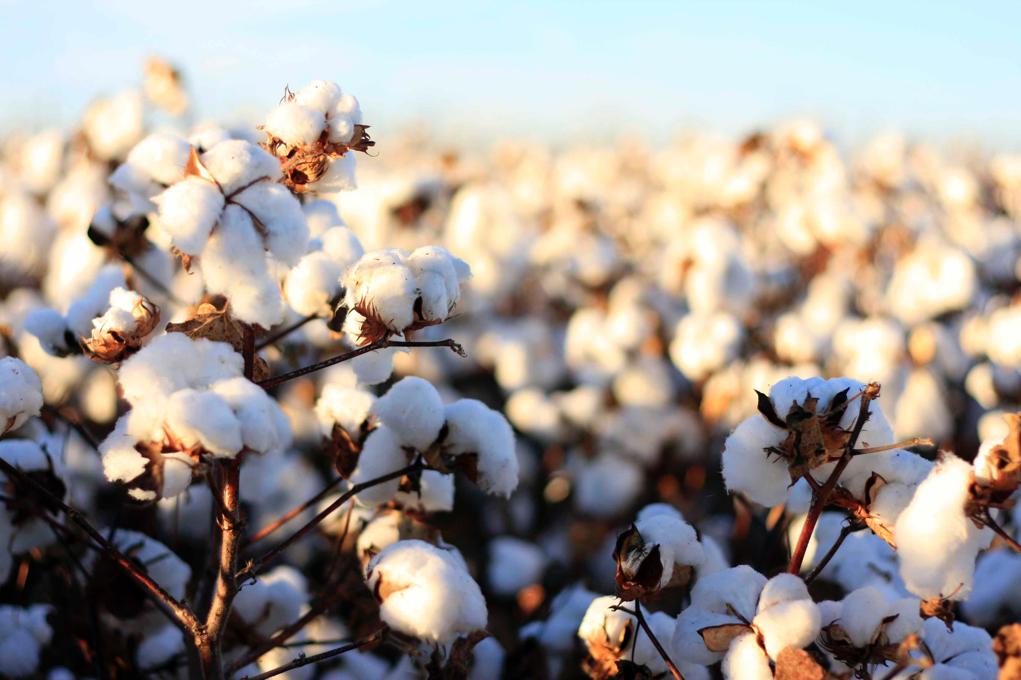
Ancient whole genome duplication in cotton
Simon Renny-Byfield

Slide 2






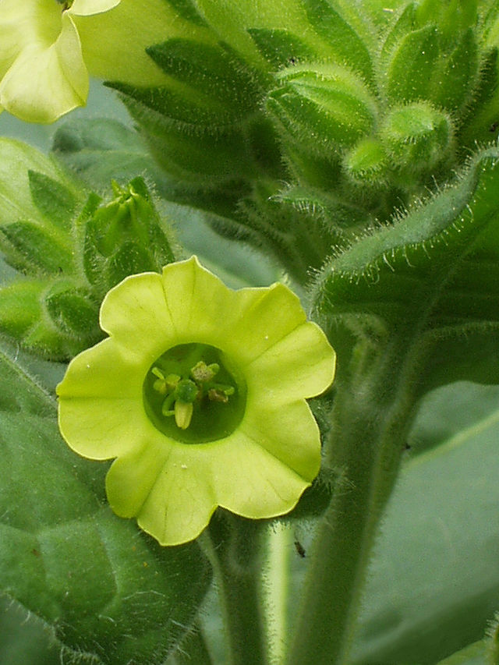

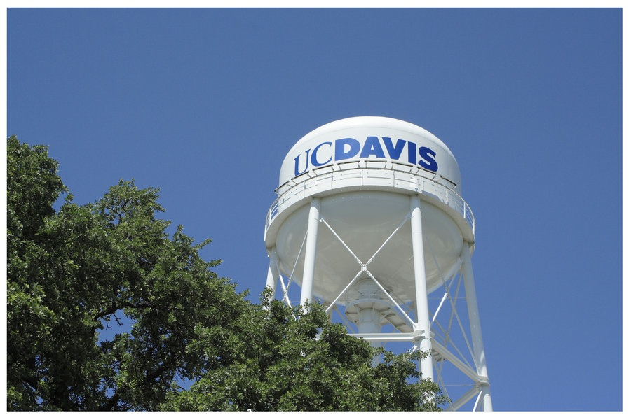
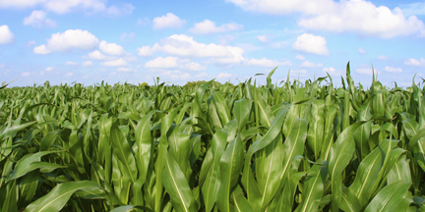
The Renny-Byfield World tour of England and America

Slide 3
outline
An intro to whole genome duplication (WGD).
WGD in the history of flowering plants.
How does the transcriptomic network respond to WGD?
What is the fate of duplicate genes following ancient WGD?

Slide 4
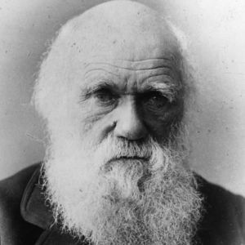
Darwin’s abominable mystery
“The rapid development, as far as we can judge, of all the higher plants within recent geological times is an abominable mystery.”

Slide 5
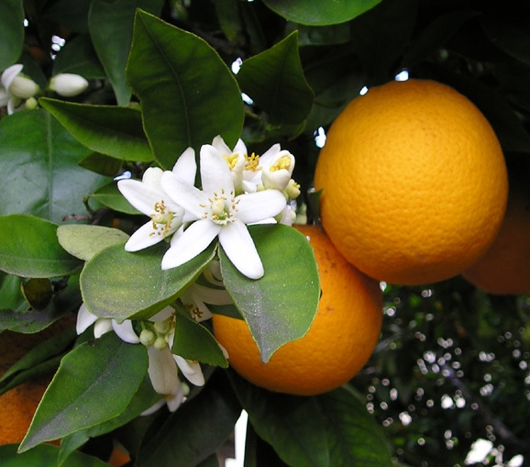
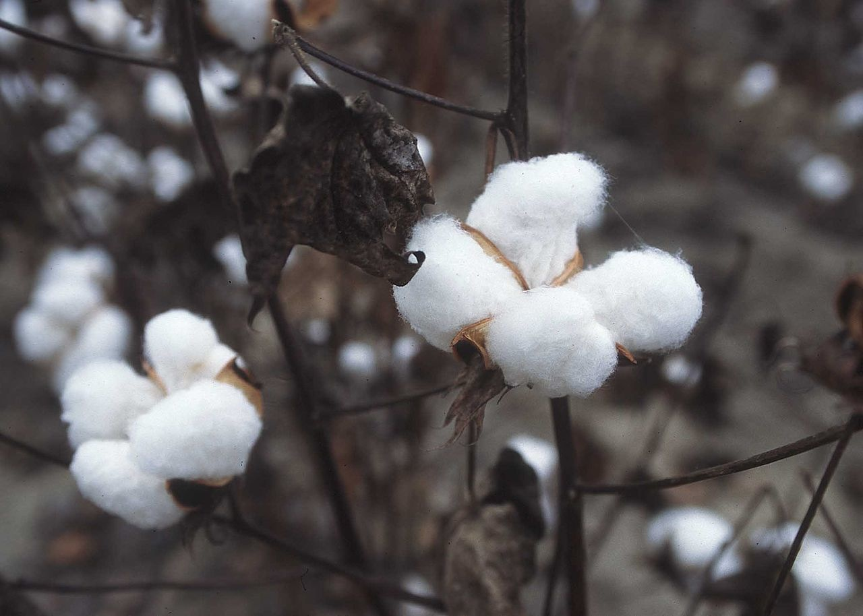
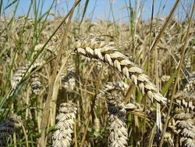
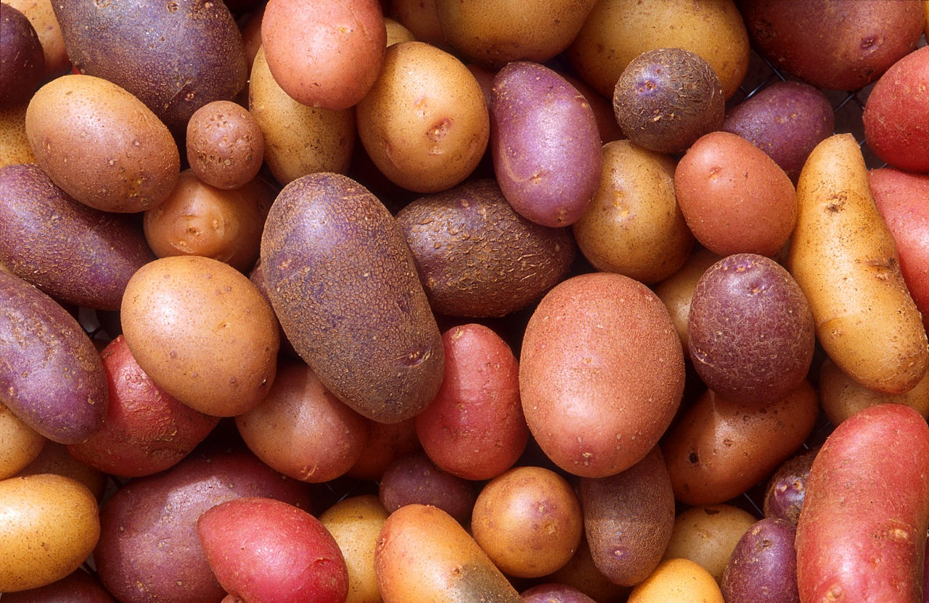
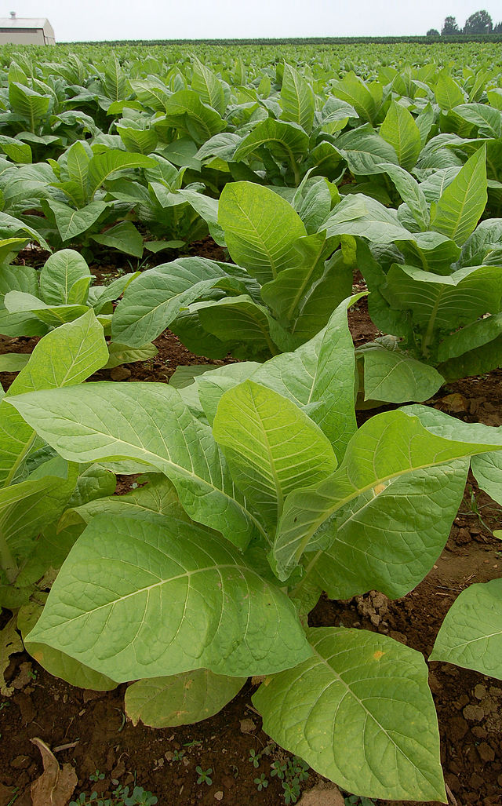
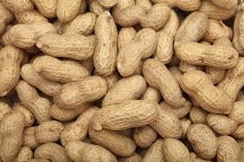
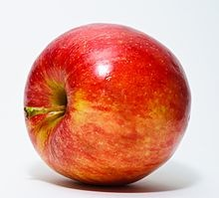
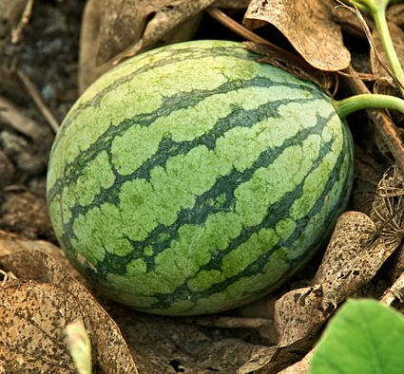
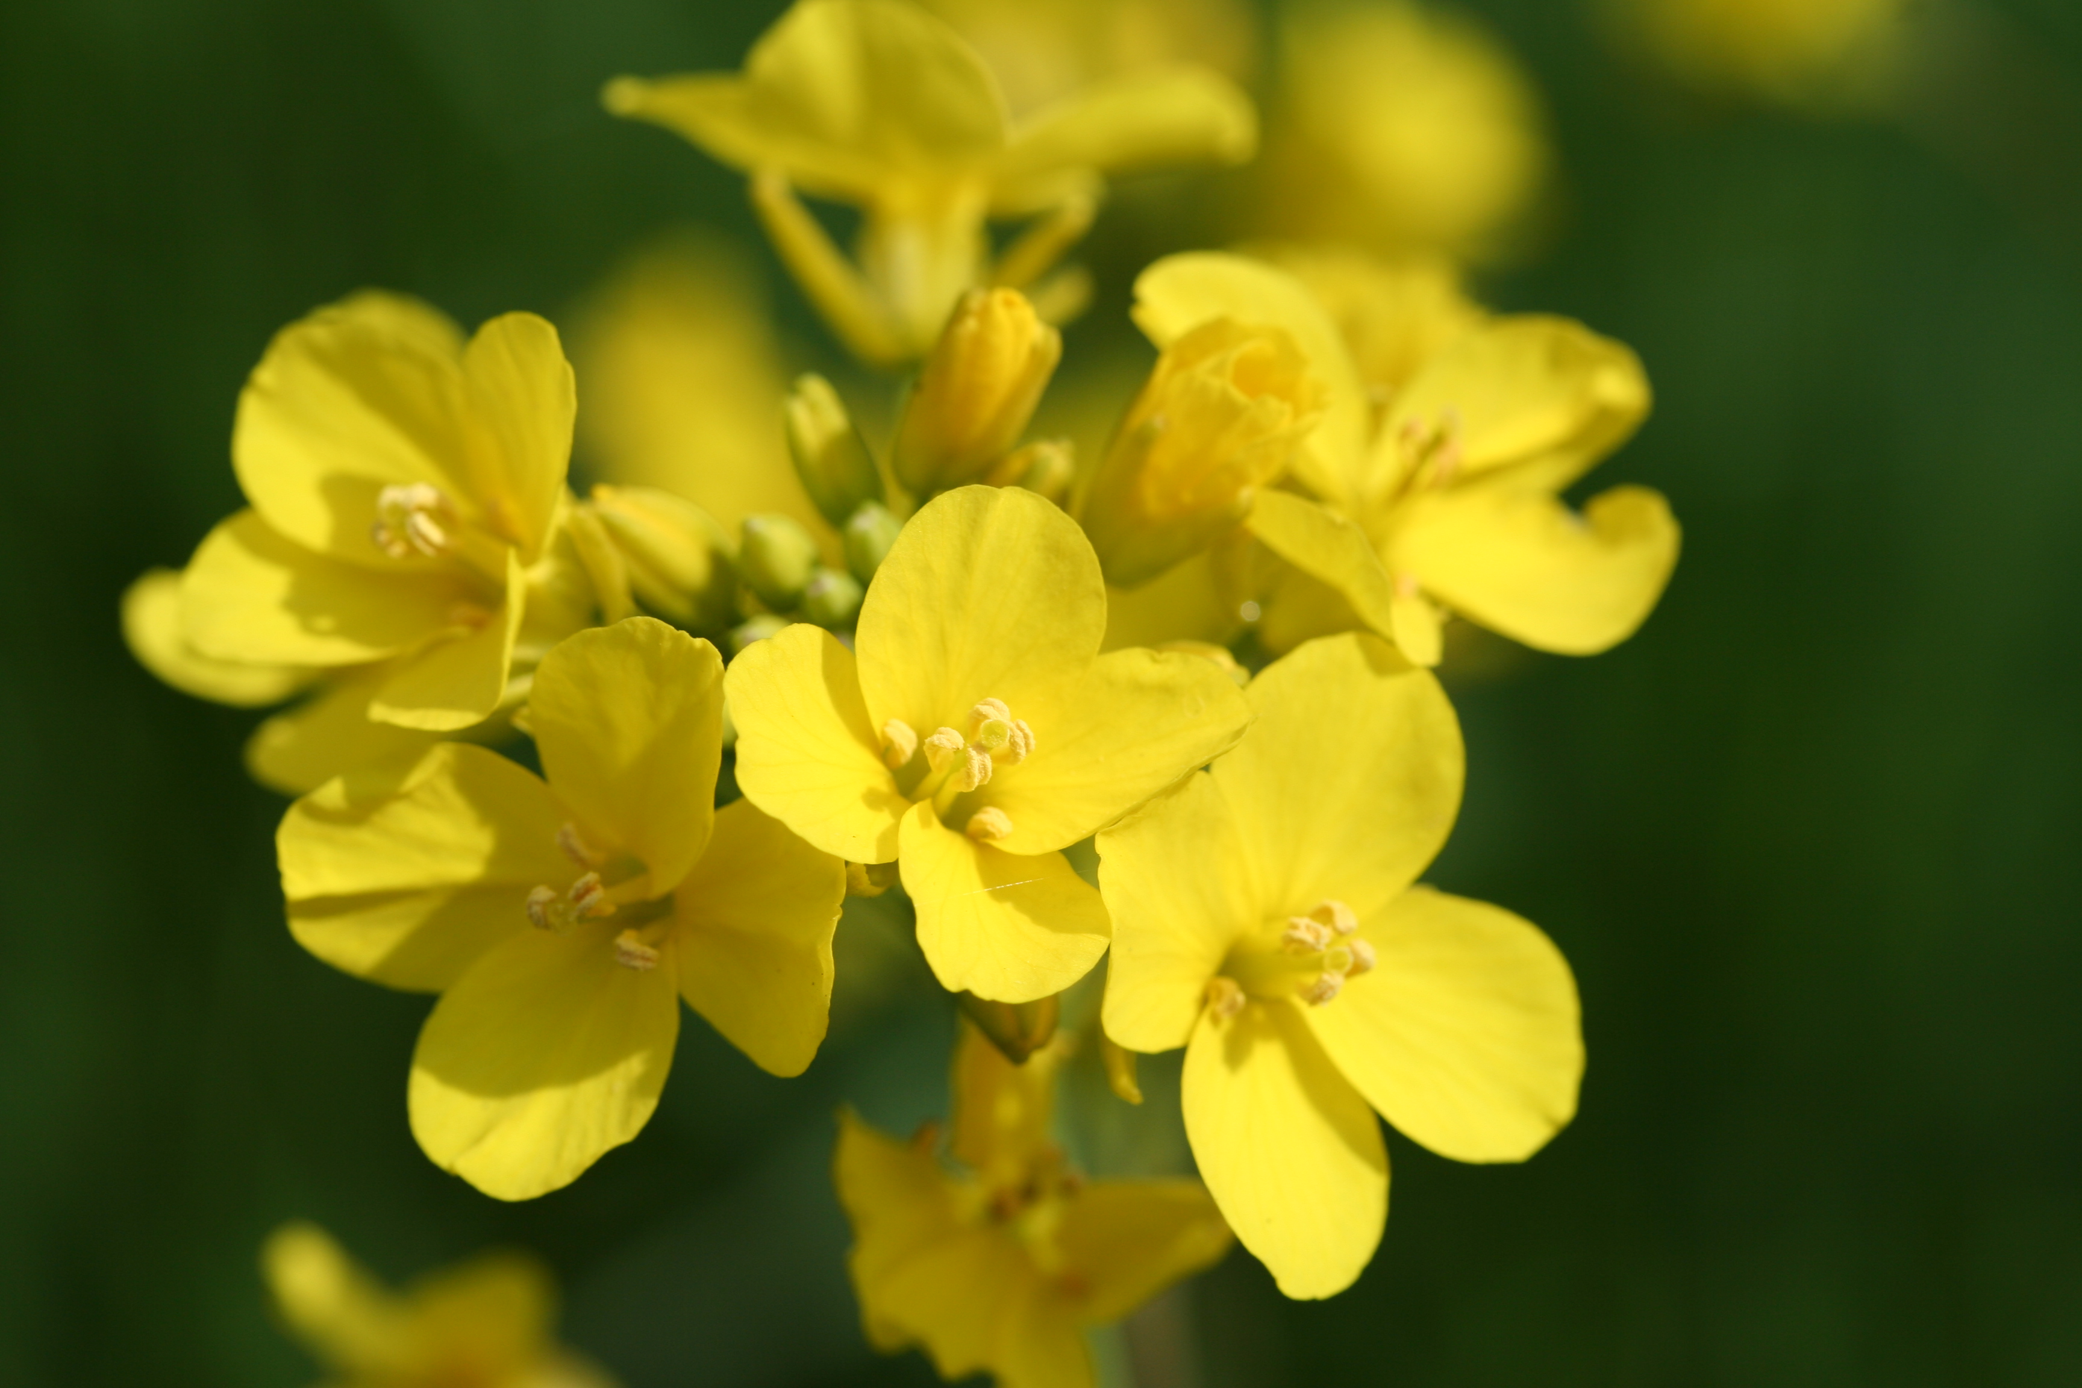
Polyploid crops

Slide 6
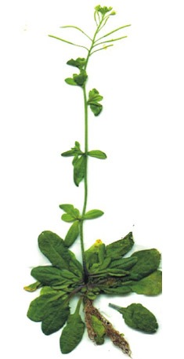
The dark secret of the angiosperms
Model “diploid” with n= 5
comparative genomics reveals α and β WGD events

Slide 7
The dark secret of the angiosperms
Schnable et al., 2011 PNAS

Slide 8
The dark secret of the angiosperms
Renny-Byfield and Wendel, American Journal of Botany, 2014

Slide 9
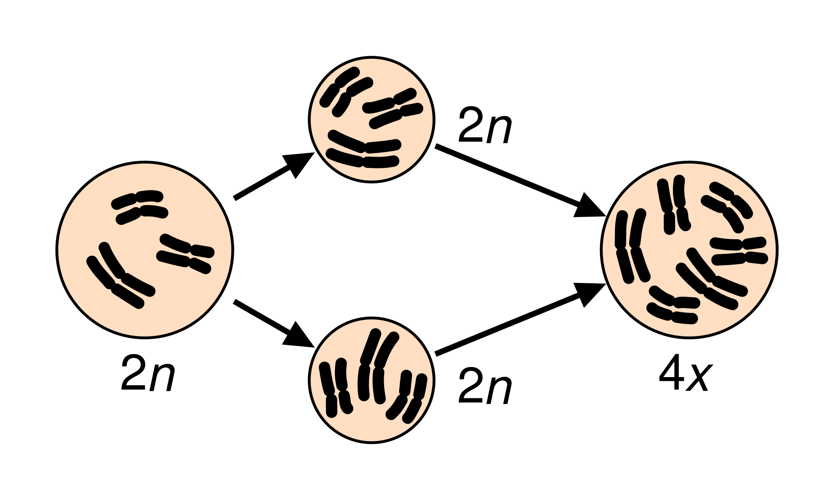
Whole Genome Duplication
Autopolyploidy
Allopolyploidy

Slide 10
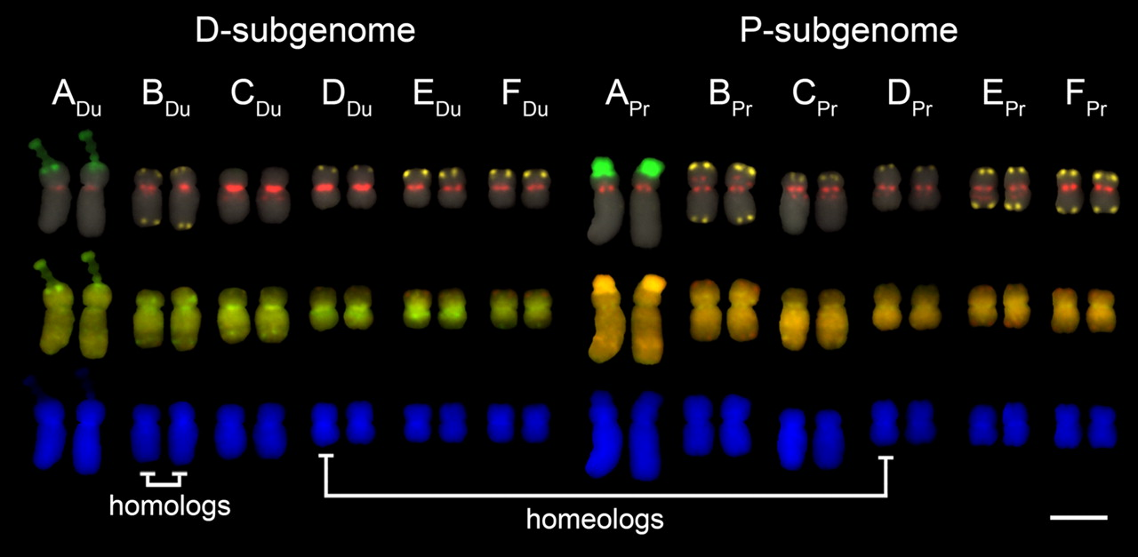
Polyploid terminology: Homolog vs Homeolog
Chester et al., PNAS 2011

Slide 11
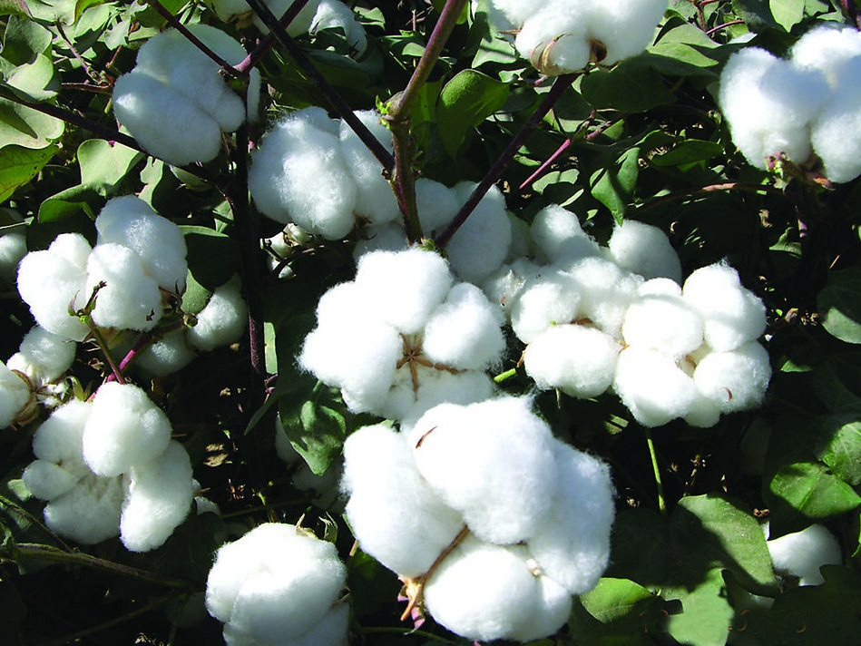
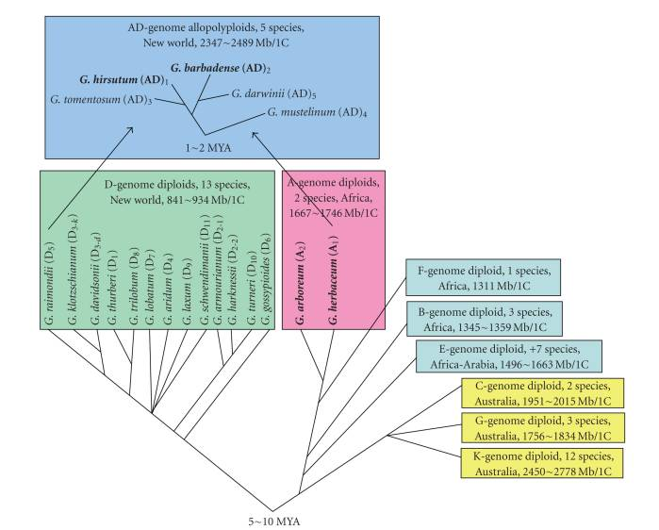
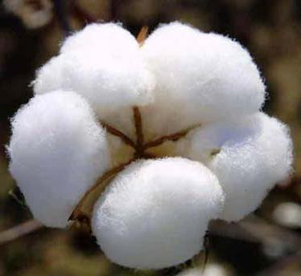
The genus Gossypium (cotton)

Slide 12
The genus Gossypium (cotton)

Slide 13
Part 1: How does the transcriptomic network respond to WGD?
How do to diverged genomes (> mya) combine a reconcile inside a single nucleus?
Are there biases in use of genes from different sub-genomes (homoeologs)?
Do any such biases change over time?

Slide 14
Gene expression in a single cell type: Fiber
5 DPA
10 DPA
15 DPA
20 DPA
G. hirsutum
(polyploid)
5 DPA
10 DPA
15 DPA
20 DPA
G. herbaceum
(diploid)
DPA = days post anthesis

Slide 15
Homoeolog expression Bias?
*
*
*
5 to ~900 homeologs depending on the stage: 37,000 total pairs.
* Significantly different at p < 0.05 level

Slide 16
Co-expression networks: WGCNA
Weighted gene co-expression network analysis is a systems biology approach.
Finding modules of highly correlated genes.
Summarizing such modules using eigengene values.
Calculating module membership.

Slide 17
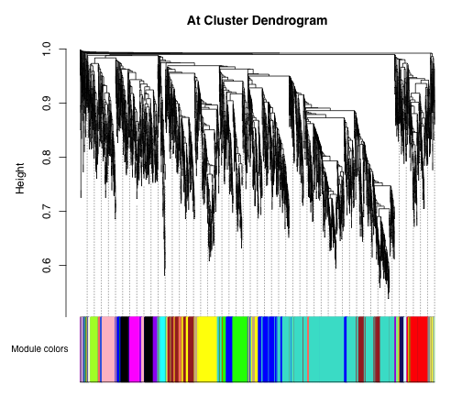
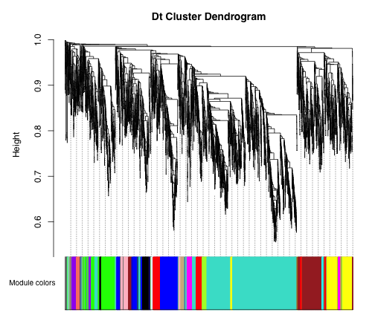
Homeologous co-expression networks

Slide 18
Homeologous co-expression networks
At network
Dt network

Slide 19
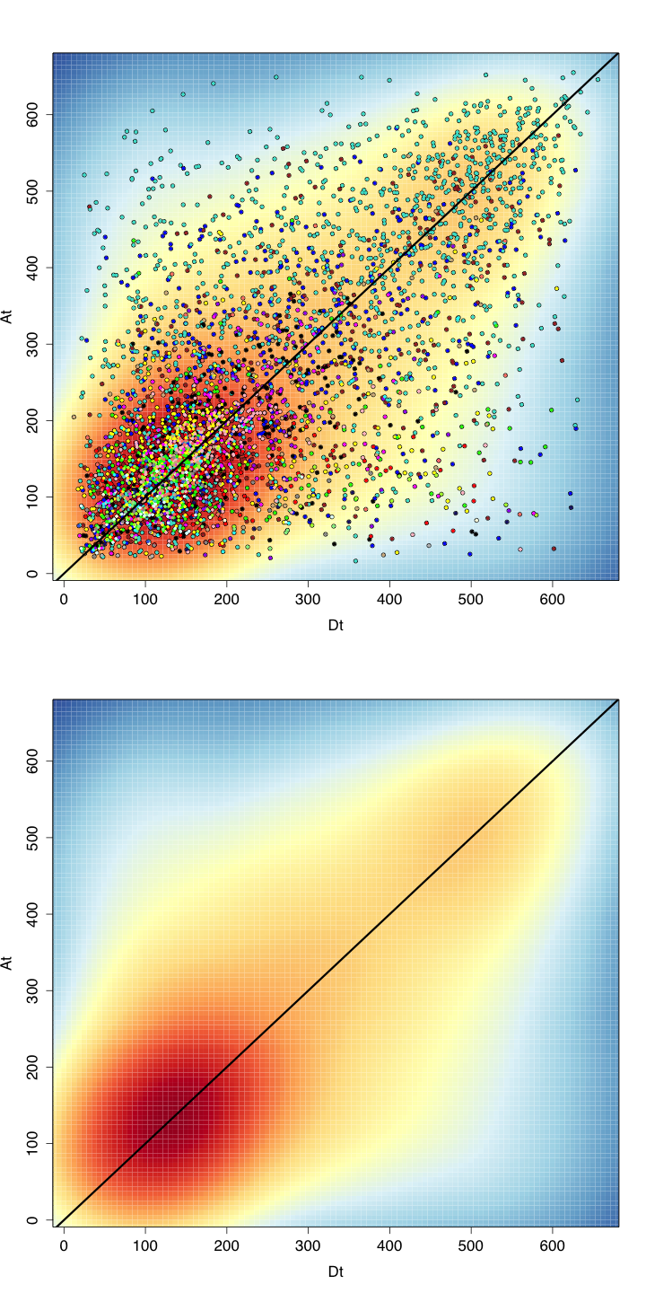
Co-expression networks: module membership
IntraModule connectivity (At)
IntraModule connectivity (Dt)

Slide 20
Co-expression networks: module expression

Slide 21
Co-expression networks: consensus modules

Slide 22
Co-expression networks: conclusions
Homeolog expression bias exists, but is minimal.
Homeolog module membership, and connectivity is broadly similar.
Expression of modules is not significantly different between At and Dt homeologous sub-networks.
At network resembles it’s Dt counterpart rather than the progenitor A1 (G. herbaceum).
Trans effects out-weigh cis? Transcriptome mimicry between homeologous sub-networks?

Slide 23
Part 2: Gene loss following ancient WGD

Slide 24
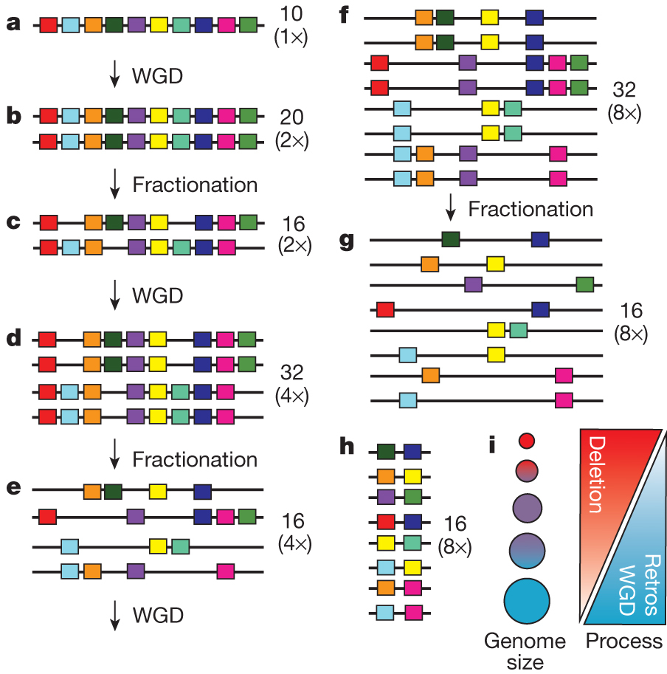
Gene loss following WGD
All angiosperm lineages have at least one WGD in their ancestry
WGD followed by gene
loss is cyclical.
Ibarra-Laclette et al., Nature 2013

Slide 25
Ancient WGD after 60 million years

Slide 26
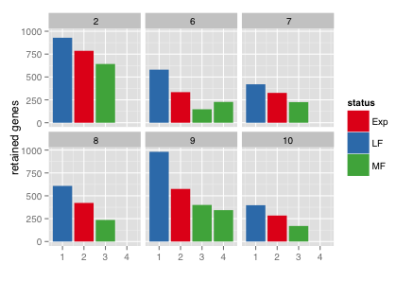
Bias in gene loss between homeologous regions
LF =
Least fractionated
Least genes lost
MF =
Most fractionated
Most genes lost

Slide 27
Bias in gene expression between LF and MF

Slide 28
What causes expression differences between LF and MF homeologs?
Transcription of TEs results in siRNA genesis.
These combine with a RISC factor and suppress expression at their source.
Almeida et al., 2005

Slide 29
siRNA targeting

Slide 30
Transposable element density and GC content

Slide 31
TEs, siRNAs and gene expression

Slide 32
Summary: Part 2
Evidence of homeolog bias in gene loss following WGD.
Associated with over expression of genes on regions experiencing less gene loss.
siRNAs are targeted to regions that have experienced more gene loss.
Little evidence that these results in down-regulation of nearby genes.

Slide 33
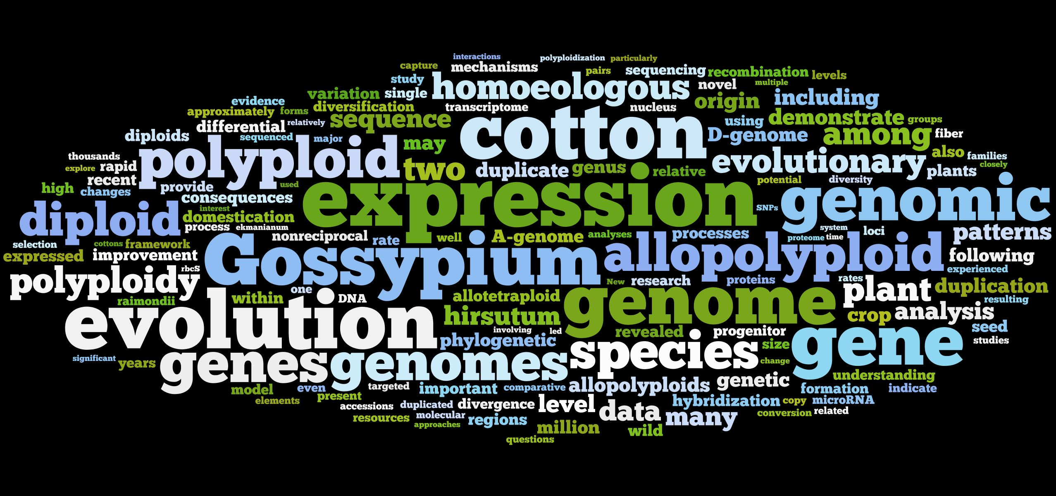
Thank you for listening!
Acknowledgements:
Jonathan F. Wendel, Joseph P. Gallagher, Lei Gong, Anna Krush, Rick E. Masonbrink, Jing Hu, Kara Grupp.

